Slide 1
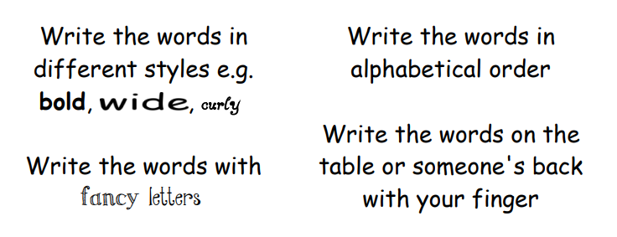
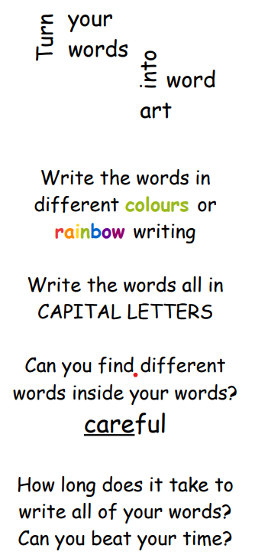
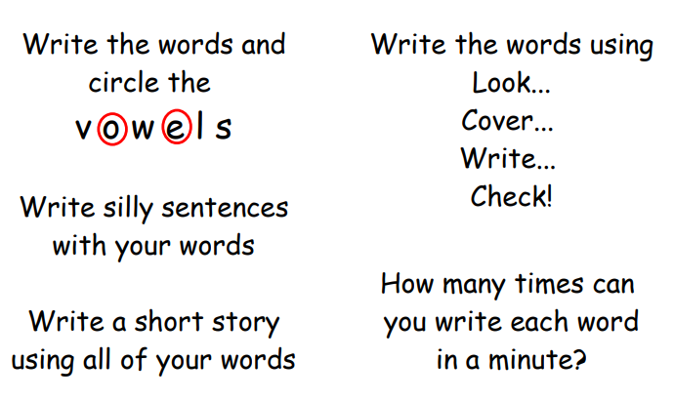
This structured approach may help you:
Look at the word and say it aloud
Read each letter of the word
Close your eyes, try to picture the word and spell it to yourself
Look at the word again? Did you get it right?
Copy the word, saying each letter as you write
Cover the word and write it out
Did you spell it correctly? If not go back to step 1.
DIFFERENT WAYS TO PRACTISE YOUR SPELLINGS

