Slide 1
Lickey Hills Primary School
PGL Boreatton Park visit
5th-9th June 2023

Slide 2
It is coming around fast!
This meeting aims to answer all questions you may have and will cover the following:
Introduction of the wonderful staff attending
Aims of the course
Glimpse of the site at Boreatton Park.
What activities the children may be doing
What a day will look like at PGL
Timings for drop off on Monday 5th June and pickup on Friday 9th June 2022
Common enquiries
An opportunity to ask any questions.

Slide 3
The staff
Mr Weston (Tuesday to Friday)
Miss Williams
Miss Smith
Mr Holloway
Mrs Green
Mrs Williams

Slide 4
Aims of the course
To become more independent, for example;
making their own beds, sorting out their own clothes, deciding when to shower – please encourage this!
To challenge themselves during activities.
To work co-operatively as part of a team.
To support the other children in their groups.
To let their dorm sleep at night.
To pitch in with duties and tidiness of their dorms.
To help those who are struggling.
To celebrate coming to the end of primary school as a year group.

Slide 5
Boreatton Park
On the website there is a virtual tour of the site - this is the website if you want to have a look at home too.
https://www.pgl.co.uk/en-gb/adventure-holidays/centres/boreatton-park

Slide 6
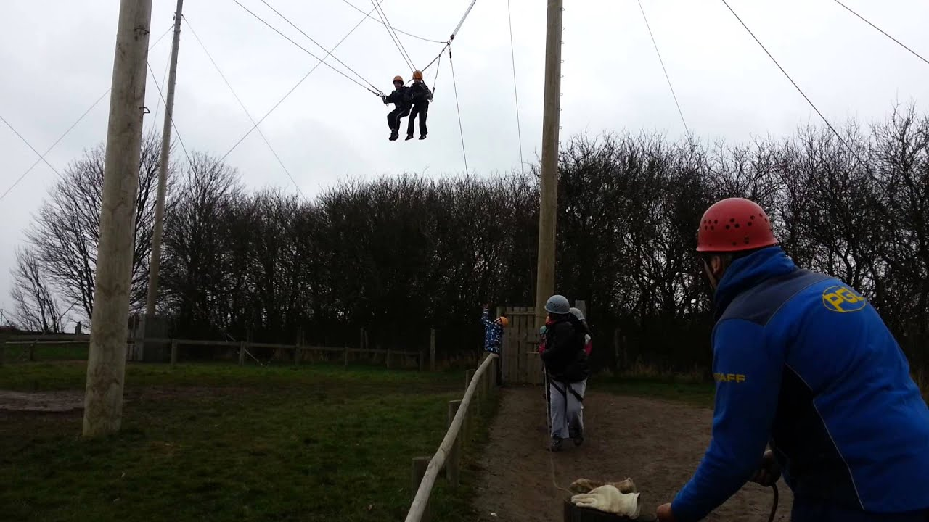
Activities - We will find out 4 weeks before we go!
Raft Building
Orienteering
Challenge Course
Canoeing
Zip Wire
Rifle Shooting
Archery
Abseiling
High Ropes Course
Low Ropes Course
Climbing Wall
Giant Swing
Trapeze
Kayaking

Slide 7
A Sample Day
Typical timings | Activities
07:00 | Your Group Leader will wake you up so that you can get up and get ready for the day ahead.
08:00 | Off to the dining room with the rest of your group to fuel up for the day, you’ll need plenty of energy to keep you going. Breakfast includes cereals, toast, yogurts, porridge, and cooked breakfast – you choose! Don’t forget to refill your drinks bottle before you head off to your first activity.
09:15 Session 1 | Giant Swing
10:45 | Break. Catch your breath and have a quick drink before your next session.
11:00 Session 2 | High Ropes Course
12:30-14:00 | Worked up an appetite? Great – it’s time to replenish your energy stores with the dining room.
14:15 Session 3 | Archery
15:45-16:00 | A chance for a breather and a drink before your Groupie takes you to your next activity.
16:00 Session 4 | Orienteering
18:00 | Time to eat again – a different menu each day (and did we mention, often evening meals come with a hot pudding too – or you can stick with fruit if you prefer).
19:00 | Talent shows, campfires, quizzes and much more – your evening entertainment programme gives you the chance to get together with everyone else in your group and have some laughs.
21:00-21:30 | Bedtime. It’s lights out and time to sleep ready to do it all over again tomorrow!

Slide 8
Clothing and Equipment
A WARM SLEEPING BAG AND A PILLOW.
An anorak or coat.
At least 3 pairs of loose fitting trousers (tracksuit bottoms are ideal – no jeans!)
4 or 5 T-shirts.
3 or 4 jumpers, sweatshirts or tracksuit tops.
At least 5 pairs of socks (preferably more) and adequate changes of underwear (including 2 pairs of thick woollen socks).
Night dress/pyjamas.
A pair of gloves and a woolly hat.
Sunhat/Cap
Toiletries (no spray deodorants), 2 towels and a plastic bag for wet clothes!
Lunch box, water bottle and torch if possible.
Trainers (plus 1 old pair for water activities or “River Shoes”).
A rucksack.
SUNCREAM

Slide 9
Common enquiries
Pocket money:
£10 is more than enough for the week. Shop will be open on final day.
Supervision:
All activities will always be led by experienced and qualified PGL staff.
Emergencies:
Should you need to contact me or your child in an emergency please ring the school first and someone will ring me.
If I need to contact you I will ring the number given on the form.
Regular updates will be sent to school and then will be text out to you.

Slide 10
Miscellaneous
Your child may bring ONE SMALLteddy bear with them if they wish.
However, they are NOT allowed to bring the following items:
Sweets, crisps or chocolates.
Mobile phones.
Tablets/SmartWatches
Nintendo switch, Vitas or any other hand held games console.
If it is expensive or electrical, it is best not to take it!

Slide 11
Medication and Consent Forms
These will be sent via parentmail in the near future and you will be notified. If you do not receive this please inform us and we will sort this.

Slide 12
Monday 5th June - Drop Off
Your child will need to be dropped off outside the school office at 12:00 on Monday 5th June. We will be departing as close to 12:30 as possible. Please make sure any medication is in a bag with the dosage/times to be taken and given to Mrs Green. The children will all need a packed lunch to be eaten when we arrive. If there are any problems with this please let us know as soon as possible.

Slide 13
Friday 9 th June - Picking Up
We will be aiming to leave PGL at around 13:00 - 13:30 after lunch and will be arriving back at school between 14:30 - 15:20, traffic depending. We will let all parents and carers know when we depart PGL for a live update.

Slide 14
Any Questions?
Thank you for your time!

