Slide 1
KS2 Reading Workshop - 11.10.22
Priorities in KS2
Teaching Structure
Home-School Expectations
Levelled Books
Support
Recommended Reads

Slide 2
Priorities in KS2
Ensure progress in the following three areas:
● Pupils’ ability to decode fluently
● Pupils’ ability to comprehend texts
● Pupils’ ability to maintain stamina and pace when reading
Promote a love of reading!

Slide 3
Priorities in KS2
Fluency:
Defined as accurate reading of connected text (decoding without error), at a conversational rate (quickly and at relative ease) with appropriate prosody (mirrors the sounds of natural spoken language).
Comprehension:
Defined as one’s understanding and interpretation of a text, and one’s ability to make connections between what they have read and what they already know.

Slide 4
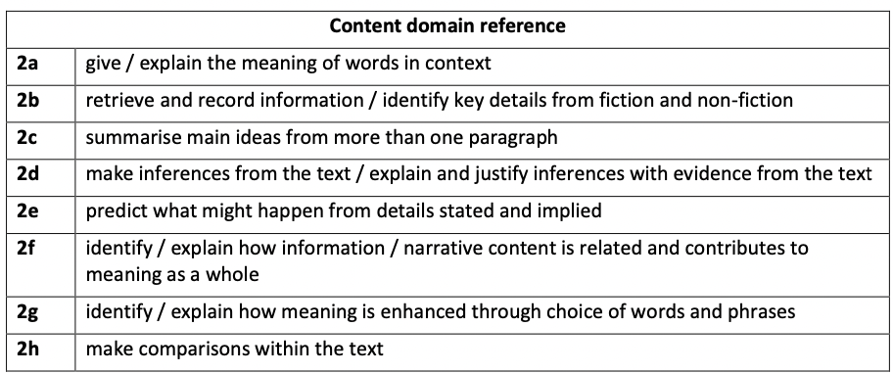
At the end of KS2, pupils should…
https://www.gov.uk/government/publications/national-curriculum-in-england-english-programmes-of-study/national-curriculum-in-england-english-programmes-of-study#years-5-and-6-programme-of-study

Slide 5
Teaching Structure - CW
V - Vocabulary (Victor)
I – Inference (Iggy)
P - Prediction (Pip)
E - Explaining - Authorial Intent and Compare and Contrast (Ella)
R – Retrieval (Rex)
S – Summarising and Sequencing (Sheba)

Slide 6
How we teach reading in KS2:
Teaching Structure:
‘VIPERS’ is our whole-school approach to teaching reading comprehension (we use high-quality texts to do this)
New texts are introduced during standalone English lessons (at the beginning of each unit), separate to the ‘VIPERS’ session. During this time, pupils are made aware of the author, illustrator and genre of the text
Written work in ‘Reading Skills’ books is completed twice weekly
Session 1 (Vocabulary and Fluency Focus); Session 2 (VIPERS skills); Session 3 (VIPERS skills)
At the end of each chapter, pupils should summarise what they have read
Pupils read for pleasure on a daily basis (with one extended session per week)

Slide 7
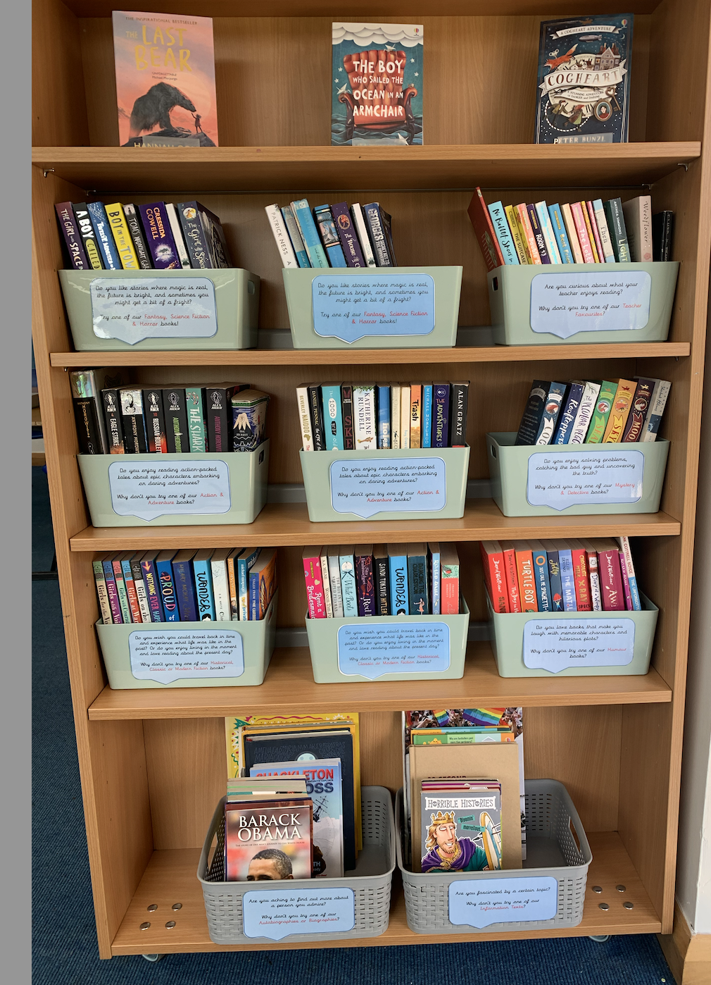
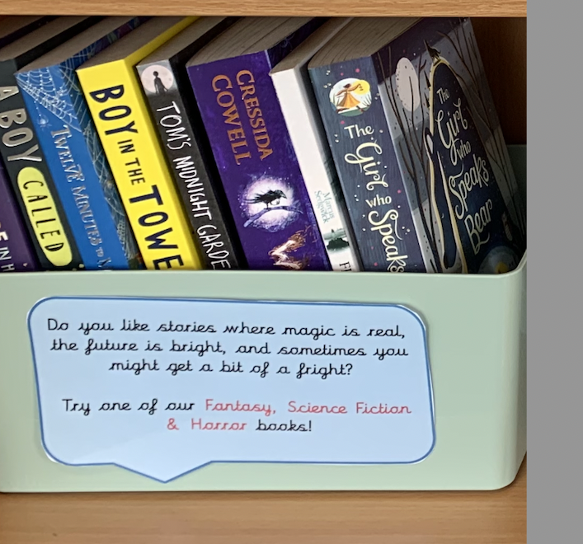
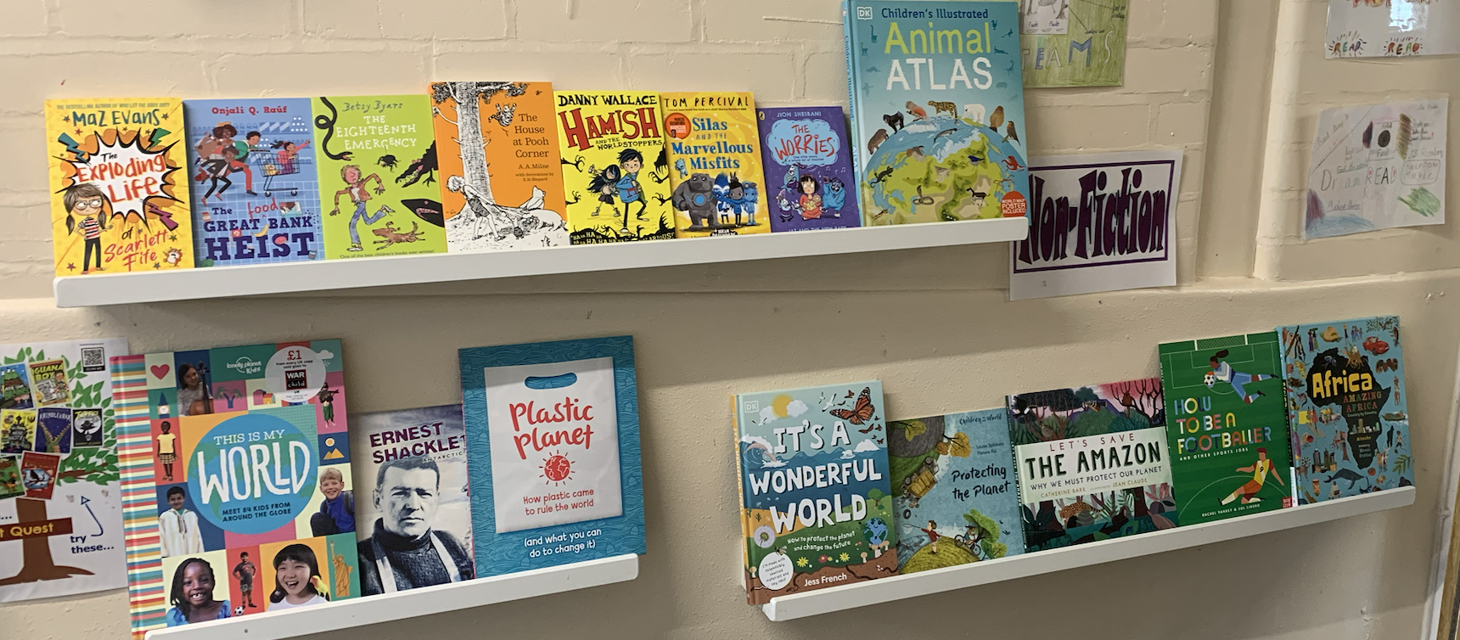
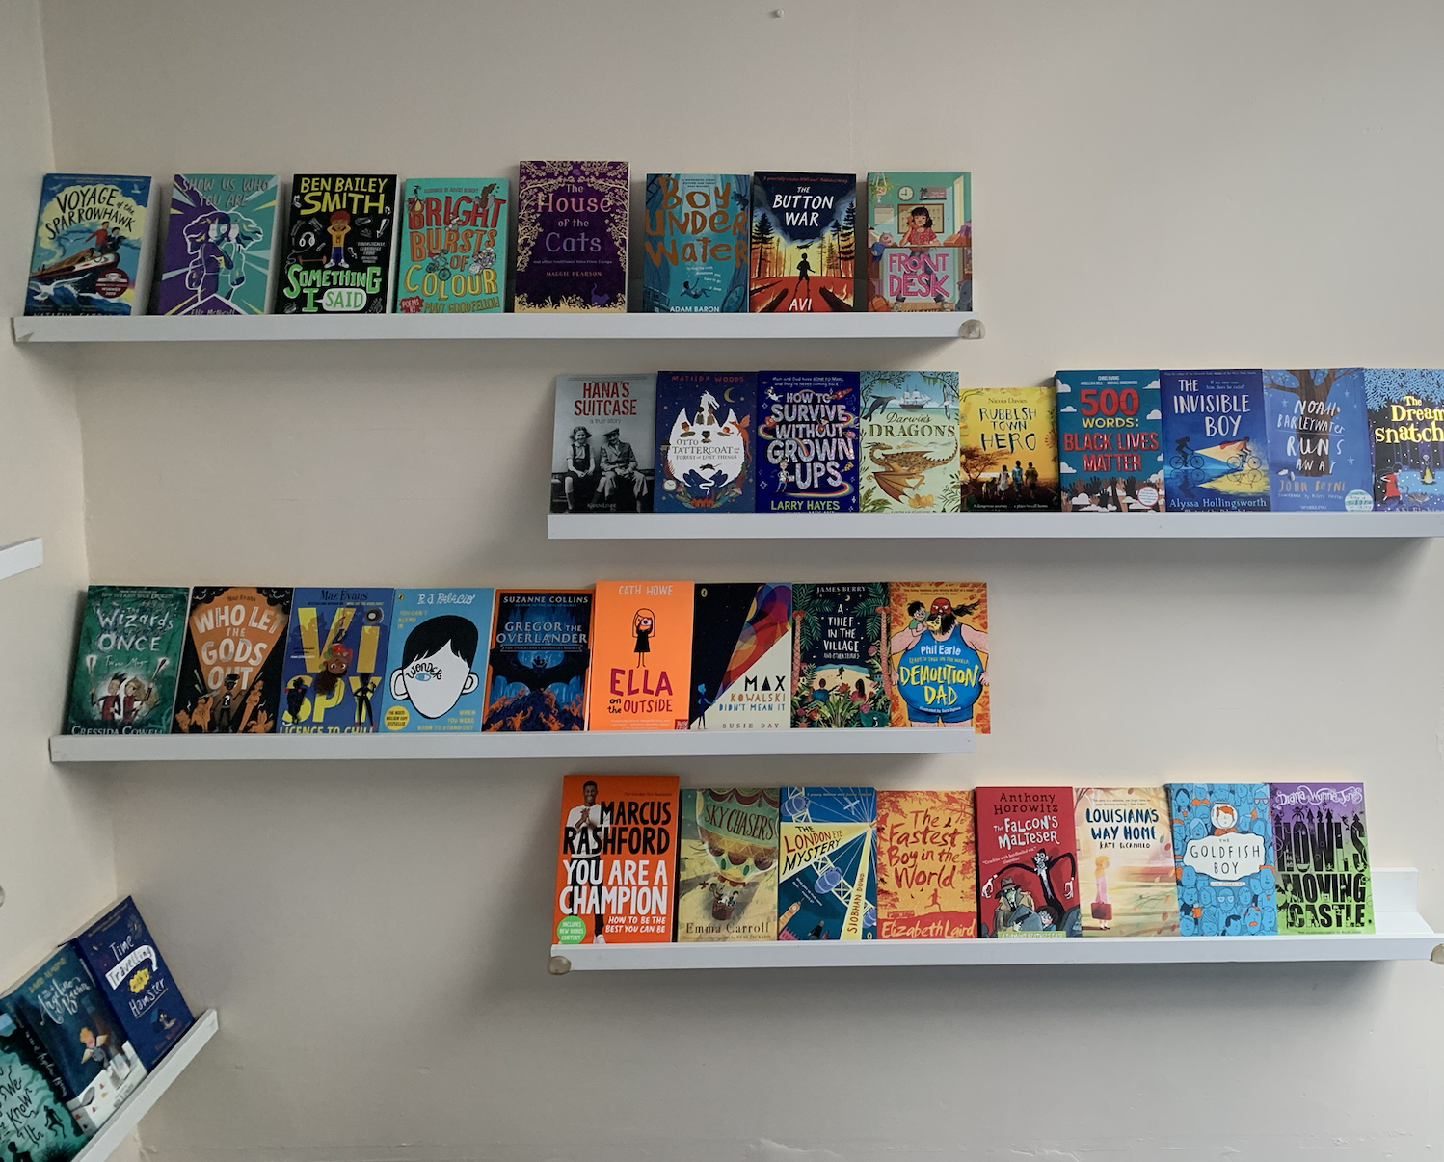
Our Books!
Recommended Reads + ORS Scheme

Slide 8
Home-School Reading Expectations
It is a parent’s/ carer’s responsibility to sign the reading record each week to show that your child is reading to you 3x 20-minutes each week. They can read a mixture of their ORS books and/or other reading material (e.g. books, newspapers, online articles, recipes). If parents/carers do not sign the reading record, then class teachers will follow the 3 steps below:
1st instance of no reading – Class Teacher will remind the pupil.
2nd instance of no reading - Class Teacher will write a note in the reading diary to inform parents/ carers.
3rd instance of no reading – Class Teacher to inform Assistant Head Teacher, who will write a letter to parents/ carers.
There will also be a fee of £5 for those who fail to return these books/ return their books in a damaged state as the ORS books are brand new and worth a lot of money.

Slide 9
Levelled Books for KS2
New for Autumn 2022 - Oxford Reading Scheme Books!
Rationale: To ensure that pupils have a book they can access and are exposed to a wide range of genres and text types; to broaden their vocabulary and background knowledge.
Children’s books will be issued each Friday (providing that they have been read and understood)
Teachers will monitor pupils’ understanding and fluency throughout the term, updating books when necessary
Our ‘Story Wall’ and classroom books are not banded.

Slide 10
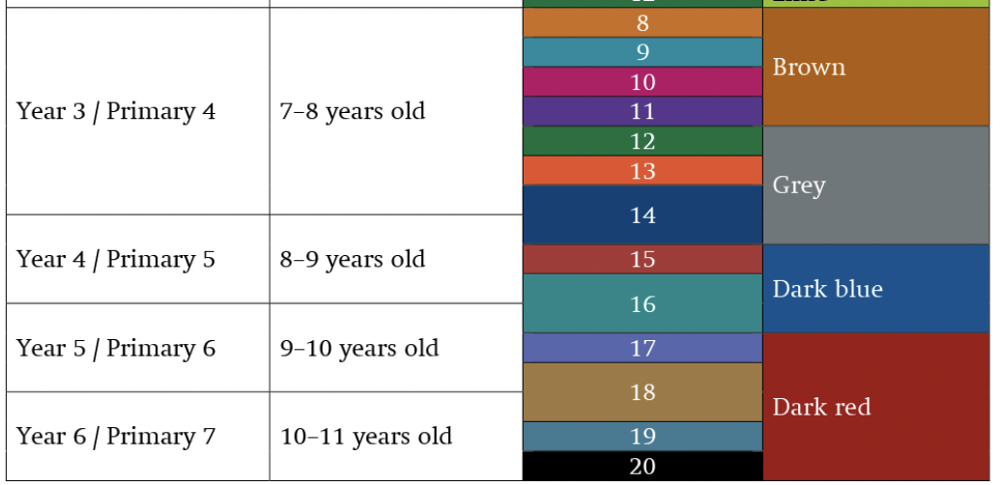
Oxford Reading Levels

Slide 11
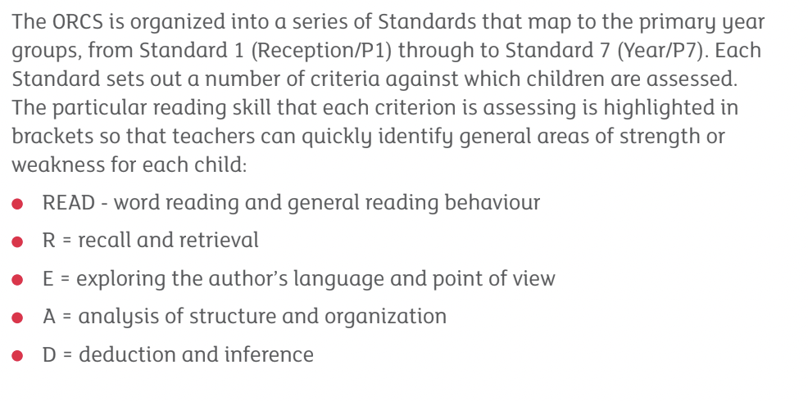
Criterion Sheets
We use the ORS criterion sheets to decide upon which book band your child will be allocated, paired with our own teacher judgement as previous assessments conducted in school.
Please be patient as we continue to assess your child’s strengths and weaknesses. We really appreciate your cooperation with this.

Slide 12
Reading Interventions
Reading interventions are part of our timetable in KS2
If your child is part of a reading intervention group, they may be given two books to take home (one that they are reading in the intervention group and one they can access independently)
Re-reading texts and reading aloud will support the development of your child’s fluency - because of this, our first intervention is always a pre-read, then the second allows the children to practise what has been read

Slide 13
How to support fluency at home:
Model fluent reading (when reading together, or when reading to your child)
Ask your child to read aloud a given passage in a set time frame
Echo reading - you read a phrase aloud and your child copies (mimicking your expression and pace)
Choral reading - reading aloud together
Marked reading - revisit errors that your child has made while reading aloud and correct them/ keep practising these words or passages
Re-read favourite books

Slide 14
How to support comprehension at home:
When reading together, ask your child lots of questions (wh questions): who, what, where, why, when?
Ask your child to make predictions about what will happen next, justifying these with evidence from the text
Ask your child to summarise what they have read at the end of each chapter
Model ‘comprehension strategies’, such as how to work out the meaning of unknown words, why characters might act or feel a certain way
Read a range of texts (from different genres) - this will introduce pupils to new vocabulary, themes and build their background knowledge

Slide 15
TRUST:
Take turns to make plans and predictions before reading: ​‘I wonder if… what do you think?’ ​‘You think… Oh, I thought…’
Recap to check ideas and understanding as your child is reading: ​‘So, you think that…’ ​‘Did you expect…to happen?’ ​‘Why do you think that happened?’
Use encouragement and praise to keep children engaged in reading: ​‘What brilliant ideas…let’s see what happens.’ ​‘You thought so carefully about… What might happen now?’
Share prior knowledge and past experiences that link to what is being read: ​‘Have you learnt about…at school?’ ​‘Do you remember when we watched…and found out about…’
Tune-in and listen to your child – be curious about their interests: ​‘I didn’t know you knew so much about…’ ​‘I love reading stories about…with you.’
Of course, aim to convey a love of reading too!

Slide 16
Recommended Reads:
https://peters.co.uk/100-books-for-every-year-group-primary
https://shop.scholastic.co.uk/reading-spine
https://schoolreadinglist.co.uk/category/reading-lists-for-ks2-school-pupils/
https://www.booksfortopics.com/year-3
https://www.booksfortopics.com/year-4
https://www.booksfortopics.com/year-5
https://www.booksfortopics.com/year-6
https://www.booksfortopics.com/branching-out

