Slide 1
Lickey Hills Primary School and Nursery
Phonics and Early Reading Workshop
September 2022
A copy of the phonic slides shared 20/9/22. Please note the accompanying videos can be found on the EYFS and Year 1 webpages.
Notes:
phonics and early reading

Slide 2
Aims
What is phonics and how do we teach it at Lickey Hills?
How do we get children ready to read?
To develop parents’ confidence in helping their children with phonics and reading

Slide 4
Phase 1: Getting ready for phonics
Nursery begin with daily phonic activities as one of their family group sessions.
Tuning into sounds
Listening and remembering sounds
3. Talking about sounds
Environmental sounds - sound walks
Instrumental sounds - match the instrument
Body sounds - silly noises
Rhythm and rhyme - nursery rhymes
Alliteration - silly soup
Voice sounds - sound effects in stories
Oral segmenting and blending
Notes:
Nursery rhymes, songs, action rhymes.
Add sound effects to stories.
Music and movement: rhythm, guess the instrument.
Talking about sounds: listening walks, loud/soft, high/low, silly noises.
Speaking & listening: silly sentences “Happy Harry hops”, mimics, animal sounds.

Slide 5
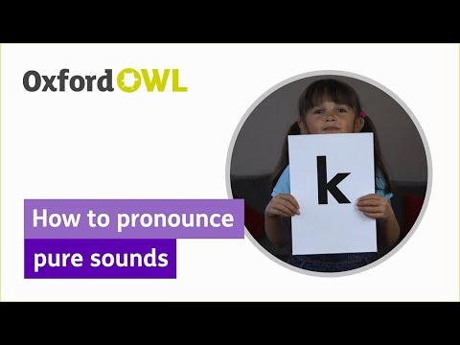
Saying the sounds
Sounds should be articulated clearly and precisely.
We use ‘soft sounds’ or ‘pure sounds’ and discourage the use of ‘Schwa’ (adding ‘uh’ onto the end of a sound)
Notes:
If we mispronounce these sounds we will make reading harder for our children.
NOT MATCHING TO A LETTER

Slide 6
How can I help at home?
Children need to be able to hear each sound and put it together to represent a whole word.
Oral blending:
toy game
Children need to practise hearing a series of spoken sounds and merging them together to make a word.
Notes:
scatter toys - NO ROBOT ARMS need to hear sound in the word and squash them together or push them together to say the whole word.

Slide 7
How can I help at home?
Hearing initial sounds:
I spy game
Notes:
video of sound talk and blending

Slide 8
How can I help at home?
Hearing sounds:
This is called segmenting
Children need to be able say every sound that they hear within a word.
Robot game
Notes:
squash sounds together

Slide 9
What is Phonics?
A method of teaching children to read and pronounce words by learning to associate letters, or letter groups, with the sounds they represent.
There are 44 main sounds in the English language but only 26 letters!
Notes:
primary strategy for reading
Each sound is represented by a grapheme (the written representation of a sound)

Slide 10
Daily Phonics
Daily, through Reception and Year 1, children have a class phonic session which lasts about 20-40 minutes.
We use a simple, consistent fast paced approach.
Lessons adopt the same classroom routines each session.
We use Essential Letter and Sounds as our government approved phonic programme.
In every single ELS lesson, your child will make the direct application to reading.
Independent application allows us to identify children who may need additional support
“Keep up not catch up”
Notes:
Phonic knowledge is assessed through independent work in workbooks.
regular assessment - child secure in knowledge not yet taught will have a longer text as a Support read with a few words they can’t read yet and/or Richer Read book to maintain interest
we can’t have gaps in our phonic knowledge because each phase builds upon the previous one

Slide 11
Further Phonics Terminology
Blending & Segmenting
Phoneme: the smallest single identifiable sound in a word. For example, in the word 'cat' there are three phonemes c/a/t.
Grapheme: the written representation of a sound.
Digraph: two letters making one sound. For example, /sh/ in the word 'shop'.
Trigraph: three letters making one sound. For example, /igh/ in the word 'night'.
Split digraph: two vowel letters split but are split by one or more consonants. For example, /i-e/ in the word 'kite'.

Slide 12
Phase 2: Learning phonemes to read and write simple words
Children will learn their first 19 phonemes:
Set 1: s a t p Set 2: i n m d
Set 3: g o c k Set 4: ck (as in duck) e u r
Set 5: h b l f ff (as in puff) ll (as in hill) ss (as in hiss)
They will use these phonemes to read and spell simple “consonant-vowel-consonant” (CVC) words:
sat, tap, dig, duck, rug, puff, hill, hiss
All these words contain 3 phonemes.

Slide 13
Blending
t i n = tin
m u g = mug
Blending video

Slide 14
Segmenting
dog = d – o - g
sun = s - u - n
hat = h – a - t

Slide 15
Harder to Read and Spell words
There are many common words that the children cannot use their known sounds for when they first meet them e.g. she We teach the children to sound these out and to spot the ‘tricky’ part. Eventually the children learn to read these on sight.

Slide 16
Phase 3: Learning the long vowel phonemes
Children will enter phase 3 once they know the first 19 phonemes and can blend and segment to read and spell CVC words.
They will learn another 26 phonemes:
j, v, w, x, y, z, zz, qu
ch, sh, th, ng, nk, ai, ee, igh, oa, 00, ar, oo, ur, or, ow, oi, ear, air, ure, er, ow
They will use their known phonemes to read and spell words:
chip, shop, thin, ring, pain, feet, night,
boat, boot, look, farm, fork, burn,
town, coin, dear, fair, sure

Slide 17
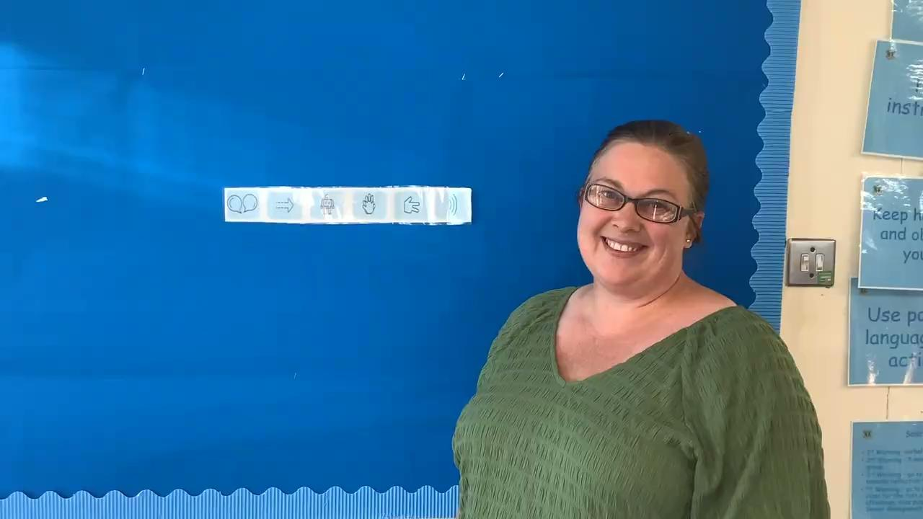
Let’s look at this word
How many sounds can you count?
night
Segmenting video
Notes:
blending hands count the number of phonemes

Slide 18
Phase 4 is now incorporated into phase 3 because no new GPCs are introduced
. Words include consonant clusters and are longer, containing four or more phonemes.
These words have consonant clusters at the beginning: spot, trip, clap, green, clown
…or at the end: tent, mend, damp, burnt
…or at the beginning and end! trust, spend, twist
Notes:
not flashing as sp tr, children need to identify the separate sounds
suffixes

Slide 19
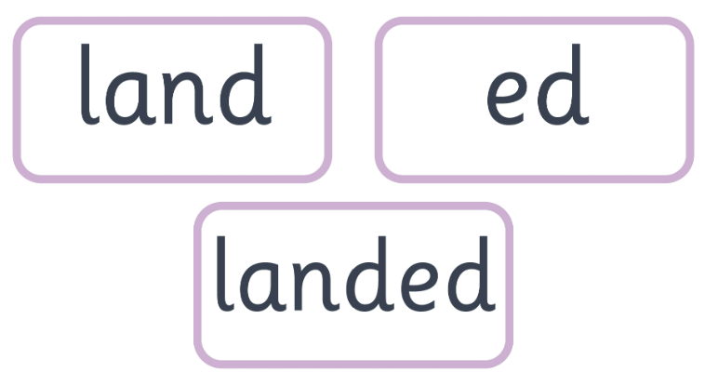
suffixes
Notes:
adding a string of letters to end of a word e.g. -ed, -ing, -er

Slide 20
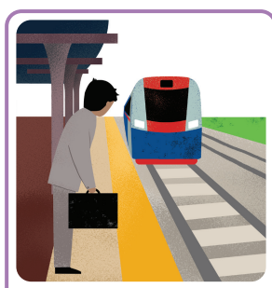
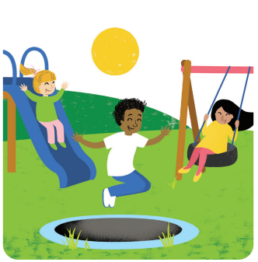
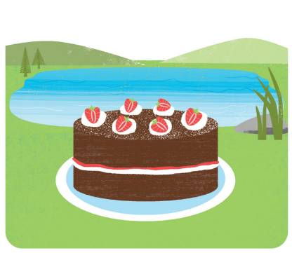
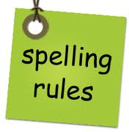
YEAR ONE: Phase 5
Continue to build their phonic skills
Begin to learn spelling rules and patterns
Improve their reading speed and accuracy
Phase 5 starts with the most common alternative spellings for known sounds.
ay, ou, ie, ea, oy, ir, ue, aw, wh, ph, ew, oe, au, and
split digraphs a-e, e-e, i-e, o-e, u-e
.
a-e
ai
ay
ay
ai a_e a
ay
Notes:
ai - wait for the train ay- play all day a-e - cake by the lake
same sound different letter(s)
ay is used at the end of a word or syllable - day, play, crayon
In the middle use a_e or ai - snake, bake, snail, train
Very few words use ei or ey - veil, vein, reindeer, they, grey
only 3 words use 'ea' for the long vowel sound /ai/ break, great & steak

Slide 21
Learn alternative pronunciations of graphemes (the same grapheme can represent more than one phoneme):
Fin/find, cat/cent, got/giant, but/put, cow/blow, tie/field, eat/bread, farmer/her, hat/what, yes/by/very, chin/school/chef, out/shoulder/could/you.
Notes:
same letter, different sound

Slide 22
Examples of alternative pronunciations:
Fin/find, cat/cent,
yes / by / very,
chin / school / chef,
Notes:
same letter, different sound

Slide 23
Learning all the variations!
Learning that the same phoneme /er/ can be represented in more than one way:
burn
first
term
heard
work
Notes:
spellings are so important
for /er/ no rules, rely on visual memory
ur and ir more common in the middle of a word; er is more common at the end of a word; ‘o’r says /er/ when it is preceded by the letter w

Slide 24
Learning all the variations!
Learning that the same grapheme can represent more than one phoneme:
meat bread
he bed
bear hear
cow low

Slide 25
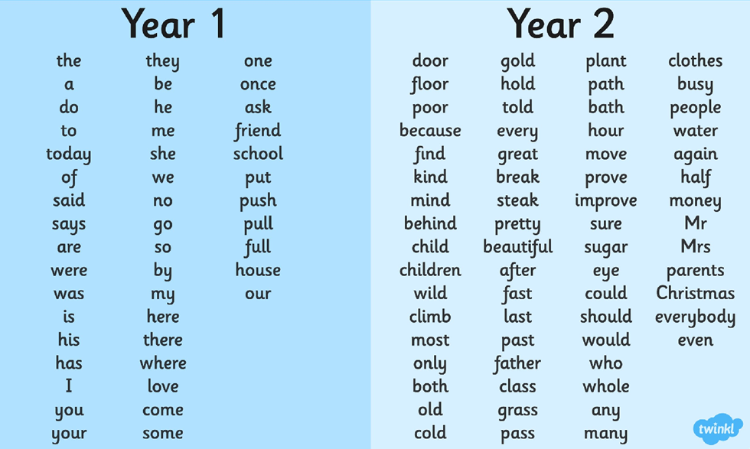
Spelling rules are taught alongside phonics in Year 1

Slide 27
Phonics is only part of reading, it unlocks the code of the written language.
When pupils read fluently, their cognitive resources can be redirected from focusing on decoding and onto comprehending the text.
60-90 words/min
Notes:
brain power is thinking about the meaning of what they are reading - like driving a car, changing gears and talking
This is when students start making their shift from learning to read, to reading to learn.

Slide 28
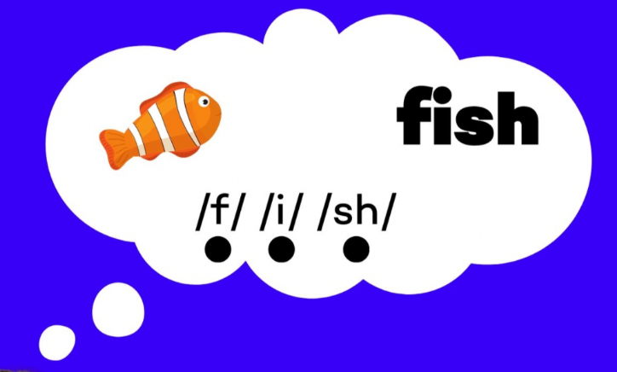
Fluency and helping at home
To read fluently, or well, we need a strong orthographic map.
Some children need up to 30 exposures to a word before they don’t need to sound it out again.
1- read to decode, sounding out and blending words
2. read for fluency, re reading without sounding out
3- read with intonation and expression
We need to read words many times to build fluency for reading.
1- decode the text
2- read for fluency
3- read with expression
Early Reading video
Notes:
Paired reading - which is a research-based fluency strategy , encourages cooperation and supports peer-assisted learning.
who struggle with reading are reluctant to read out loud, paired reading can offer a low-pressure way to practice their skills.
no longer need to focus on identifying and blending individual sounds in words.

Slide 29
Your support is critical
Only 1 in 3 children are read a bedtime story night
Reading a bedtime story every night to your child improves their outcomes.
If your child views themselves as a ‘good reader’ when they leave Primary School they are more likely to earn a higher salary in their 40s.

Slide 30
At home
Read regularly – not just the books from school, Oxford Owl, books from the library and from their own book boxes. We recommend 10 minutes each day, whether it’s you or them reading.
Help your child practise their phonemes. Encourage the ‘soft sounds’
Play games in the car – what sound does that start with? Can we segment and blend the word?
Pairs - matching words to picture cards.
Magnetic letters / Flour / Glitter words
https://www.phonicsplay.co.uk/member-only/Phase3Menu.htm
www.letters-and-sounds.com
https://www.oxfordowl.co.uk/welcome-back/for-home/reading-owl/advice-for-parents
https://www.youtube.com/watch?v=EYx1CyDMZSc

Slide 31
Thank you!
Please do come and see us if you need further guidance

