Slide 1
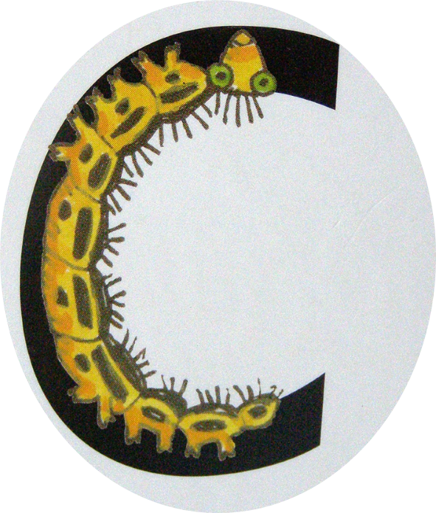
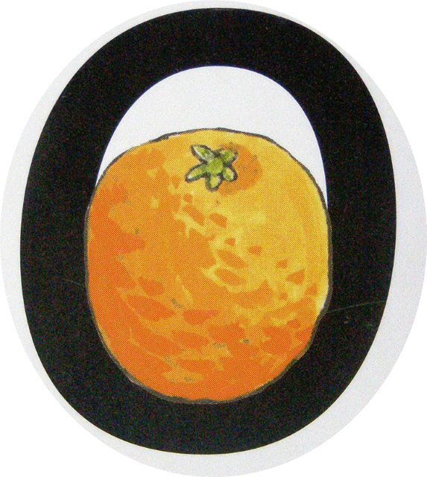
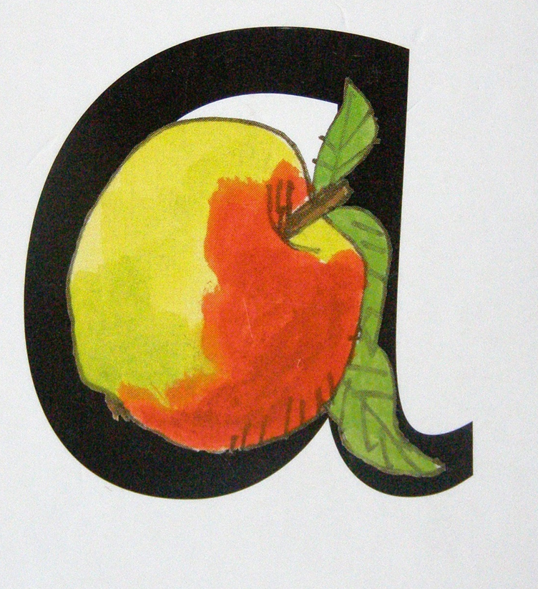
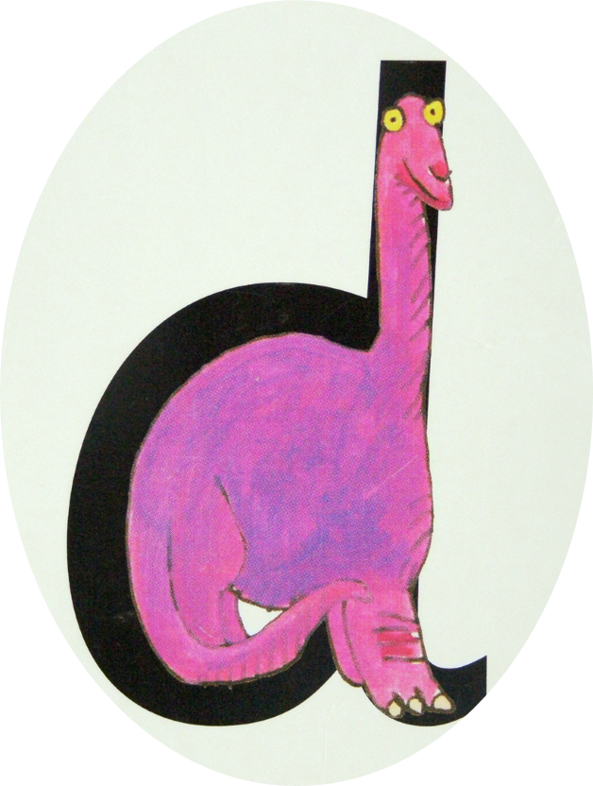
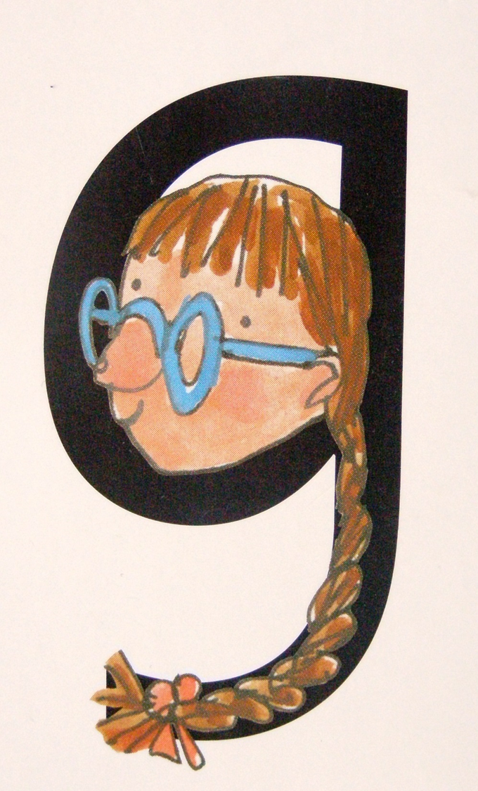
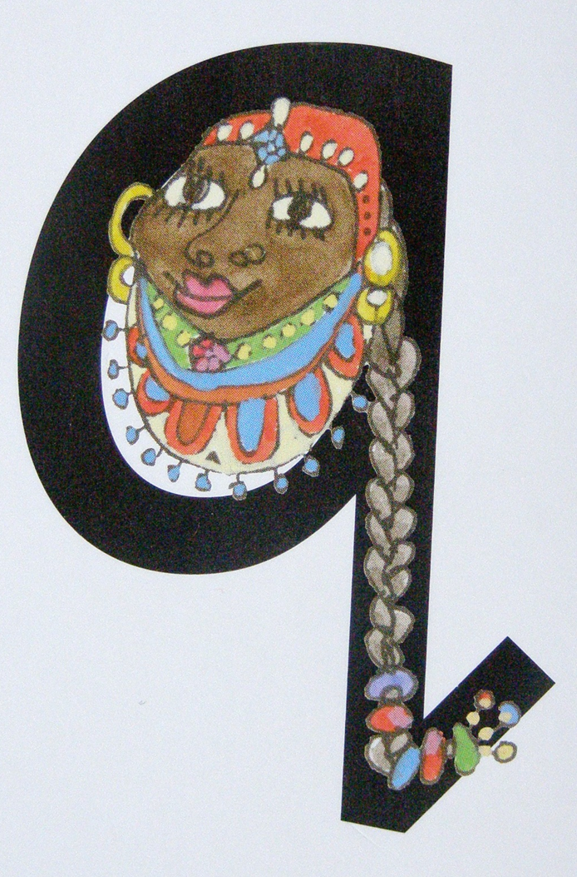
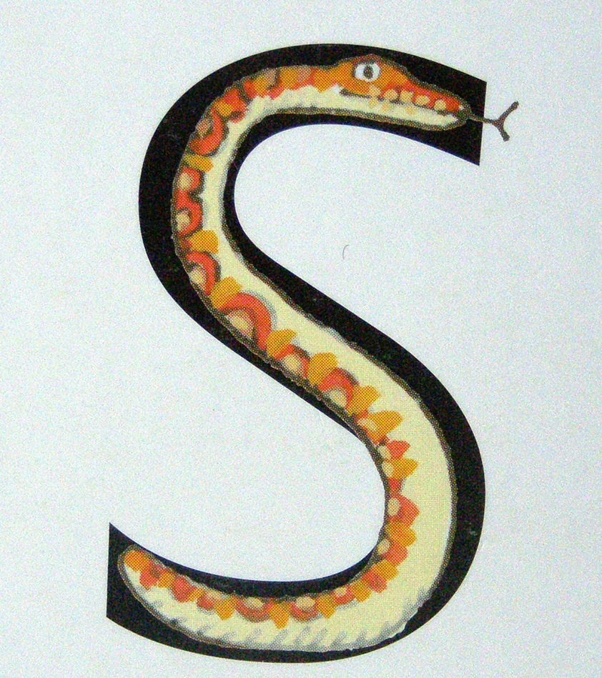
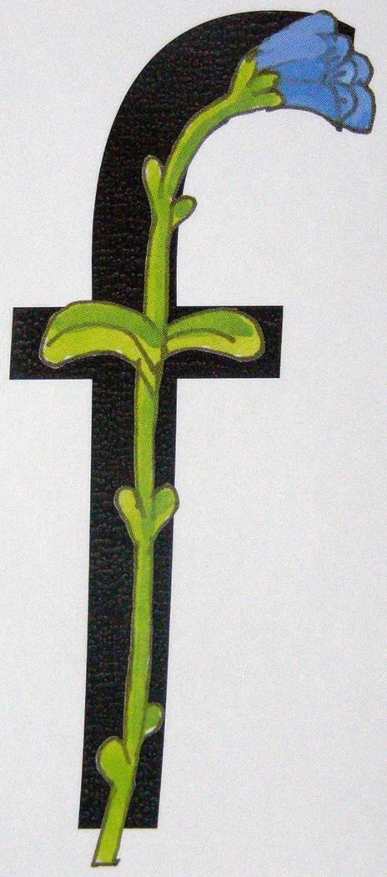
Curly caterpillar letter formation
Curl around the caterpillar
All around the orange
Round the apple and down the leaf
Round the dinosaur bottom up his neck and down
Round the girl’s face, down her curl
Round the queen’s head and down her hair
Across and scoop out the egg
Down the slippery snake
Down the stem to the roots, draw the leaves

