Slide 1
Spelling
Lickey Hills Primary School
and Nursery
March 2018

Slide 2
Aims:
No Nonsense Spelling - An introduction
Spelling expectations at the end of KS1 and KS2
Spelling at our school - A whole school overview
How we teach spelling from years 2-6 through a sequence of lessons
Spelling strategies for learning new words
Spelling strategies for proofreading
How can you help at home?

Slide 4
End of KS1 Expectations
Pupils should be taught to spell by:
•segmenting spoken words into phonemes and representing these by graphemes, spelling many correctly •learning new ways of spelling phonemes for which one or more spellings are already known, and learning some words with each spelling, including a few common homophones •learning to spell common exception words •learning to spell more words with contracted forms •learning the possessive apostrophe (singular), for example, the girl’s book •distinguishing between homophones and near homophones •adding suffixes to spell longer words, for example, ‘-ment’, ‘-ful’, ‘-less’, ‘-ly’ •writing from memory simple sentences dictated by the teacher that include words using the common exception words and punctuation taught so far.

Slide 5
End of KS2 Expectations
Pupils should be taught to spell by:
• develop a range of personal strategies for learning new and irregular words*
• develop a range of personal strategies for spelling at the point of composition*
• develop a range of strategies for checking and proofreading spellings after writing*
• use further prefixes and suffixes and understand the guidance for adding them
• spell some words with ‘silent’ letters (for example: knight, solemn)
• continue to distinguish between homophones and other words which are often confused
• use knowledge of etymology in spelling and understand that the spelling of
some words needs to be learnt specifically
• use dictionaries to check the spelling and meaning of words
• use the first three or four letters of a word to check spelling, meaning or both of these in a dictionary
• use a thesaurus
• proofread for spelling errors.

Slide 6
A whole school overview - Spelling Pathway
Year 1: Daily phonics sessions
Year 2: Daily 15 minute spelling and phonics sessions
Years 3-6: 3 sessions of spelling per week (20 minutes)
Each session focuses on learning a new spelling rule or strategy.

Slide 7
Teaching sequence
A typical teaching sequence is as follows:
Revise: Activate prior knowledge and revisit previous linked learning
Teach: Introduce the new concept and investigate model
Practise: Individual/group work. Extend/explore the concept independently
and investigate
Apply/Assess: Assess through independent application.
Demonstrate understanding.

Slide 9
Strategies for learning new words

Slide 10
Strategies for proofreading
Using personal spelling banks
Using spelling walls
Using the statutory word lists

Slide 11
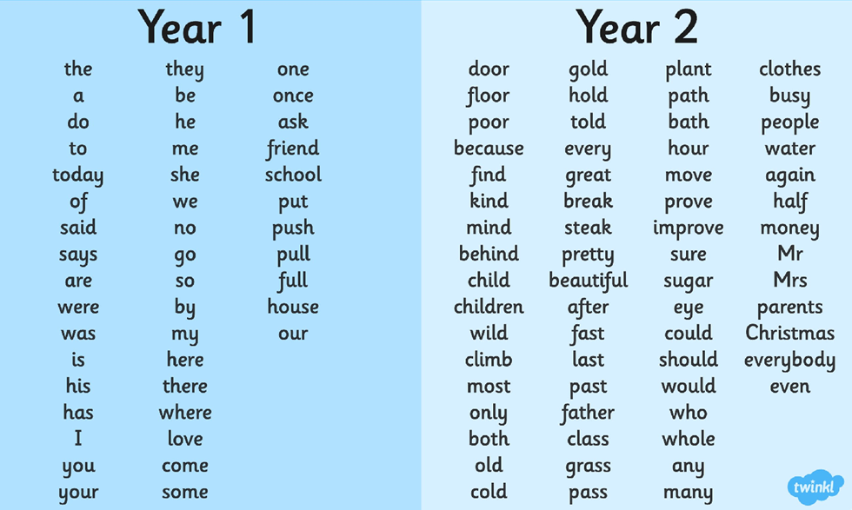
Years 1 and 2 Statutory Words

Slide 12
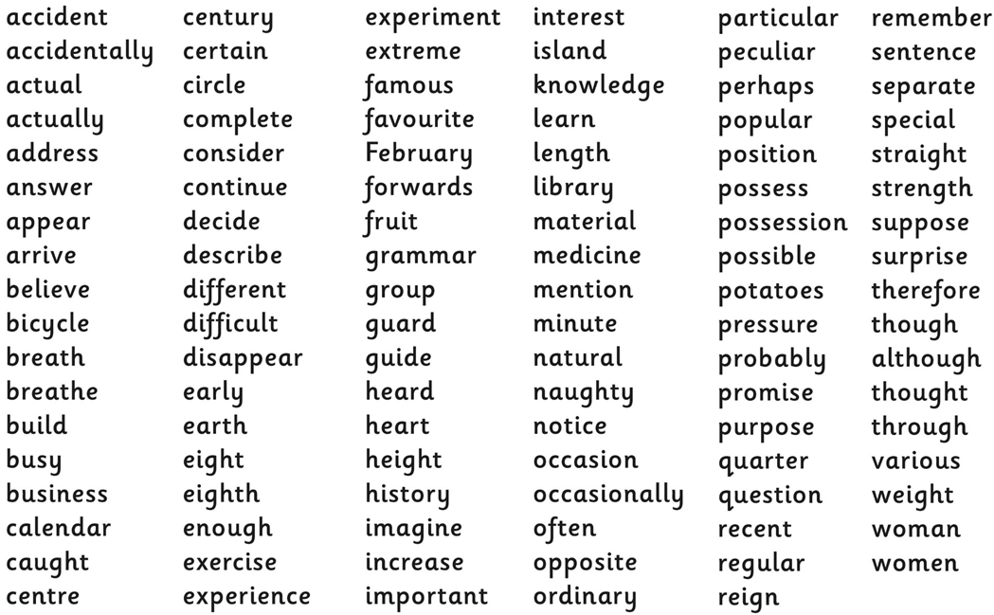
Years 3 and 4 Statutory Words

Slide 13
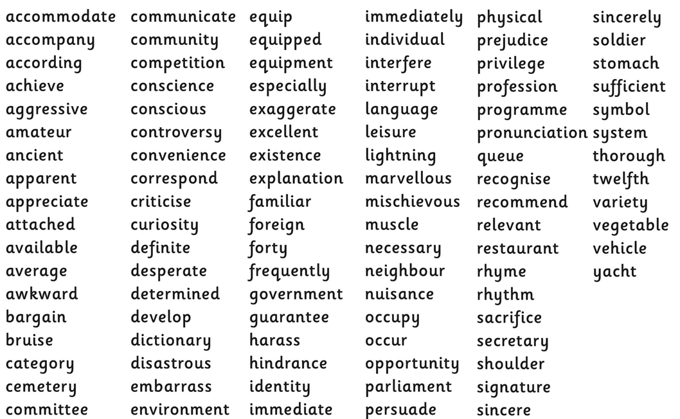
Years 5 and 6 Statutory Words

Slide 14
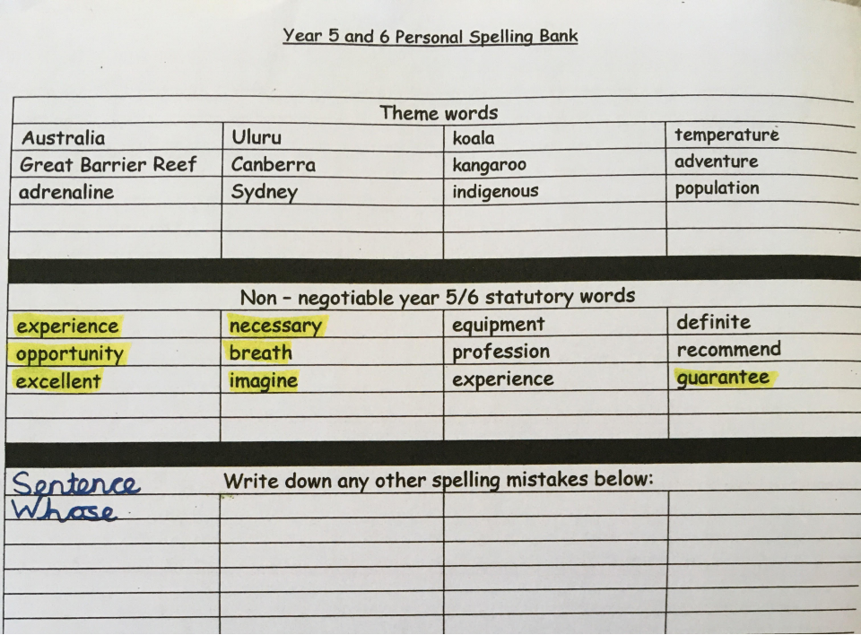
Strategies for proofreading

Slide 15
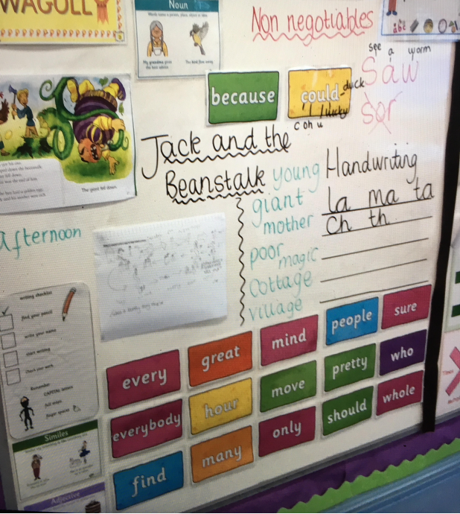

Slide 16
What can I do to help at home?
. Use the spelling strategies with your children to learn new words
. Learn words from the statutory word lists
. Play a variety of different games using their spelling words
. Websites

Slide 17
ponies
puppies
stories
teddies
families
armies
tries
cries
carries
worries

Slide 18
JUMBLE
lfsimeai

Slide 19
BOGGLE
ponies
puppies
stories
teddies
families
armies
tries
cries
carries
worries

Slide 20
Mystery Letters
_ a m_ l_ _ s

Slide 21
Making Word Searches
Designing a word search with all of their spelling words.

Slide 22
Silly Sentences
Write a silly sentence that makes sense using as many of the spelling words as possible.

Slide 25
Websites
http://www.manythings.org/cts/
https://www.phonicsplay.co.uk
https://www.spellzone.com/games/index.cfm
https://www.topmarks.co.uk/english-games/5-7-years/words-and-spelling
http://www.aaaspell.com/
http://www.spellingtraining.com/

Slide 26
Thank you for your time.
All resources will be found on the Parent Page on the school website.

