Slide 1
Reading and Phonics
Lickey Hills Primary School
and Nursery
November 2017

Slide 2
Aims:
Reading at our school
Phonics at our school
How we teach reading in Key Stage One and EYFS
The expectations at end of Key Stage One
How we teach reading in Key Stage Two
The expectations at end of Key Stage Two
How parents can help at home

Slide 3
Reading at LHPSN
At LHPSN we understand that reading is a fundamental skill that underpins almost everything that we do. We also know that reading for pleasure makes a big difference to your children’s educational performance. We believe that reading should be an enjoyable experience where children are able to enjoy a wide variety of genres, discover new learning and stimulate their imagination and curiosity. Reading is one of the main key areas we teach daily alongside writing and maths.

Slide 4
Phonics at LHPSN
Notes:
4

Slide 5
Every day, across KS1 and EYFS, the children have a 20 minute session of phonics.
Children work in groups at the appropriate phase for them.
In KS2 some children continue to learn phonics.
We use a fast paced approach.
Lessons encompass a range of games, songs and rhymes.
We use the Letters and Sounds planning document to support the teaching of phonics.
There are 5 phonics phases which the children work through at their own pace, before moving onto spelling rules.
Daily Phonics

Slide 6
Phonics is all about using
skills for reading and spelling
knowledge of the alphabet
+
Learning phonics will help your child to become a good reader and writer.

Slide 7
Phase 1: tuning into sounds.
Phase 2: learning phonemes to read and write simple words
Children will learn their first 19 phonemes:
Set 1: s a t p Set 2: i n m d
Set 3: g o c k Set 4: ck (as in duck) e u r
Set 5: h b l f ff (as in puff) ll (as in hill) ss (as in hiss)
They will use these phonemes to read and spell simple “consonant-vowel-consonant” (CVC) words:
sat, tap, dig, duck, rug, puff, hill, hiss
All of these words contain 3 phonemes.

Slide 8
Saying the sounds
Sounds should be articulated clearly and precisely.
We use ‘soft sounds’ or ‘pure sounds’ and discourage the use of ‘Schwa’ (adding ‘uh’ onto the end of a sound).

Slide 9
Phonics Glossary
Your child will learn to use the term:
Blending
Putting the sounds together to read a word.
Children need to be able to hear the separate sounds in a word and then blend them together to say the whole word.

Slide 10
Blending
/b/ /e/ /d/ = bed
/t/ /i/ /n/ = tin
/m/ /u/ /g/ = mug

Slide 11
Phonics Glossary
Your child will learn to use the term:
Segmenting
Breaking up a word into its sounds.
Children need to be able to hear a whole word and say every sound that they hear.

Slide 12
Segmenting
dog = /d/ /o/ /g/
sun= /s/ /u/ /n/
hat= /h/ /a/ /t/

Slide 13
How can I help at home?
Oral blending: The robot game!
Children need to practise hearing a series of spoken sounds and merging them together to make a word.
For example, you say ‘b-u-s’, and your child says ‘bus’.

Slide 14
Phonics Terminology
Your child will learn to use the term:
phoneme
The smallest units of sound that are found within a word.
e.g. c-a-t.

Slide 15
Phonics Terminology
Your children will learn to use the term:
grapheme
This is how a phoneme is written down.

Slide 16
Phonics Terminology
Phoneme frame and sound buttons
c | a | t
. . .
f | i | sh
. . _

Slide 17
Let’s think about these words
log duck
fill

Slide 18
Here is how they are written on a phoneme frame
l | o | g
d | u | ck
. . .
. . _
f | i | ll
. . _

Slide 19
Tricky Words
There are many words that cannot be blended or segmented because they are irregular.
the was said you some

Slide 20
Phase 3: Learning the long vowel phonemes
Children will enter Phase 3 once they know the first 19 phonemes and can blend and segment to read and spell CVC words.
They will learn another 26 phonemes:
j, v, w, x, y, z, zz, qu, ch, sh, th, ng, ai, ee, igh, oa, oo, ar, or, ur, ow, oi, ear, air, ure, er
They will use these phonemes to read and spell words:
chip, shop, thin, ring, pain, feet, night, boat, boot, look.

Slide 21
Phonics Terminology
Your children will learn to use the term:
digraph
Two letters that make one sound when read e.g. ai, ch, ee, oa, ow
This means that the phoneme comprises of two letters
e.g. ll, ff, ck, ss

Slide 22
Phonics Terminology
Your child will learn to use the term:
Trigraph
Three letters that make one sound e.g. igh, ear, air
Notes:
22

Slide 23
Let’s look at these words
ring chick
night

Slide 24
Here is how they are written on a phoneme frame
r | i | ng
ch | i | ck
. . _
_ . _
n | igh | t
. _ .

Slide 25
Phase 4:Introducing consonant clusters: reading and spelling words with four or more phonemes
Children move into phase 4 when they know all the phonemes from phases 2 and 3 and can use them to read and spell simple words (blending to read and segmenting to spell).
Phase 4 doesn’t introduce any new phonemes. It focuses on reading and spelling longer words with the phonemes they already know.
These words have consonant clusters at the beginning: spot, trip, clap, …or at the end: tent, mend, damp, burnt
…or at the beginning and end! trust, spend, twist

Slide 26
Let’s look at these words
spot damp

Slide 27
Here is how they are written on a phoneme frame
p | o | t
d | a | p
s
m
. . . .
. . . .

Slide 28
Phase 5
Teach new graphemes for reading
ay, ou, ie, ea, oy, ir, ue, aw, wh, ph, ew, oe, au,
a-e, e-e, i-e, o-e, u-e Split digraphs e.g. Make, kite
Learn alternative pronunciations of graphemes (the same grapheme can represent more than one phoneme):
Fin/find, cat/cent, got/giant, cow/blow, tie/field, eat/bread, hat/what, yes/by/very, chin/school/chef, out/shoulder/could/you.

Slide 29
Learning all of the variations!
Learning that the same phoneme can be represented in more than one way:
burn
first
term
heard
work

Slide 30
Learning all the variations!
Learning that the same grapheme can represent more than one phoneme:
meat bread
he bed
bear hear
cow low

Slide 31
Teaching the split digraph
tie time
toe tone
cue cube
pie pine

Slide 32
After phase 5 - spelling rules
Children look at syllables, base words, and mnemonics.
Children will learn about past tense, rules for adding prefixes and suffixes.

Slide 33
Is there anything I can do at home?
y | e | s

Slide 34
How can I help at home?
When spelling, encourage your child to think about what “looks right”.
Have fun trying out different options. Wipe clean whiteboards are good for trying out spellings.
rain rayn
boil boyl
boy boi

Slide 35
At home
Help your child practise their phonemes. Encourage the ‘soft sounds’.
Play games in the car – what sound does that start with? Can we segment and blend the word?
Useful websites:
www.phonicsplay.co.uk
www.letters-and-sounds.com

Slide 36
This is a typical game that we would use as a warm up in our phonics lessons.

Slide 37
Thank you!
Please do come and see us if you need further guidance with phonics.

Slide 38
What is Reading?
Notes:
You can be any where in the grid. EG. you could have good comprehension of books that are read to you/ films, but not be able to decode the words.

Slide 39
How we teach reading in EYFS
In Nursery children begin to learn phonics from Phase 1.
During the week there are two sharing sessions where children read with a friend and choose a book to take home.
Each week, children read in a guided group with the teacher.

Slide 40
How we teach reading in EYFS
In Reception children read 1:1 with an adult each week.
They focus on their understanding of the story and sound recognition.
The theme each week is based on a whole class story. Through this, comprehension is taught.

Slide 41
Reading in KS1
Reading Session = daily for 25 - 30 minutes
Set phonics games on the i-pad
Task following read with the teacher
Teacher Guided Reading
TA Guided Reading
Reading for pleasure

Slide 42
Teacher and TA Guided Reading
Please welcome our special guests.
Notes:
Take a large book!

Slide 43
Teacher and TA Guided Reading
In each session a specific learning objective is chosen from the curriculum.
E.G. To make a prediction based on what has been read so far.
This will become the focus of the session.
Notes:
Take a large book!

Slide 44
Teacher and TA Guided Reading
The children will read parts of the book and work on developing towards the learning objective of the session.
Each child will read aloud to the group, while the other pupils follow with their finger.
Throughout the session, the teacher is making ongoing assessments and supporting the child to progress.
Notes:
Take a large book!

Slide 45
Pre and Post Guided Reading Activities
These are completed independently.
Pre-reading may include: looking at the cover and blurb, or practising the sounds that will appear in the book.
Post-reading may include: comprehension questions about the book, reviewing the book, or creating an alternative ending.
Notes:
Take a large book!

Slide 46
The Reading for Pleasure Book Nook
The aim is for children to choose their own books from a range of high quality texts.
We are currently enhancing this area with new book shelves and chairs designed to support comfortable reading.
Notes:
Take a large book!

Slide 47
What are the books that come home for?
These books have been explored in the Guided Reading sessions. We record this in the Reading Record.
They are for you and your child to share as often as possible.
Another book is issued at the next Guided Reading session. Please try to ensure that the book is always in the book bag.
Notes:
Take a large book!

Slide 48
How can I help at home?
Promote a love of reading - books, comics, websites.
Provide a range of books for your child. The library is free to join!
Ask your child to read aloud to you.
Record your comments in the Reading Record to share your observations with us.
Ask comprehension questions.
https://www.booktrust.org.uk/books/100-best-books/
https://www.theguardian.com/books/2011/oct/22/recommended-reads-children-5-7
Notes:
Take a large book!

Slide 49
Common Queries
Q. My child can read much longer words than those in the book that comes home.
Thank you for raising this point. Conversation between school and home is vital! Sometimes, the reason for this is that we are working on comprehension and deduction. We are also working on the objectives surrounding discussion with peers.

Slide 50
Common Queries
Q. Why are the children grouped? Can the children move groups?
The children are grouped to allow learning through discussion with peers. They listen to others of the same age reading and work together to improve. Grouping allows focused teaching for pupils with similar needs. Small groups also allow more personal feedback for younger children than whole class teaching.
All grouping is flexible. Due to our ongoing assessment, we can move pupils whenever we feel that it will be beneficial.

Slide 51
How is reading assessed?
Ongoing assessment in the guided reading sessions and during lessons.
Tracked through the online tracking system.
PIRA reading tests each term to support our teacher judgements.
All of the assessments inform our teaching and grouping.

Slide 52
End of Key Stage 1 Expectations
There are three categories: working towards the expected standard, working at the expected standard, working at greater depth within the expected standard.
Please refer to your pack for more details.

Slide 53
Thank you
Please do come and see us if you need further guidance with early reading.

Slide 54
How we teach reading in KS2
A daily, extended literacy lesson within which the children read a high quality text specifically chosen to compliment the literacy curriculum and themes.
Time is given to analyse the text in-depth, exploring the use of language, the structure and its themes and will often include close oral questioning by the teacher to further children’s understanding.
Every child during the week will be invited to read aloud. If a text is particularly challenging, children may also be given a ‘pre-read’ or chance to read in smaller group with support prior to the lesson.

Slide 55
How we teach reading in KS2
Each school day starts with a 15-minute ‘feed the read’ session. This is a time for children to independently read a text of their choice, and is intended to encourage a love of reading in all children.
All children bring a book home to read – a book of their choosing from a range that are age/ ability appropriate.
All children can choose to use the ‘story walls’ to borrow a book of their choice from a continually-changing range of selected children’s books - both new books and classics. The children themselves have played a massive part in the choices of books we have bought.

Slide 56
For children who need extra support:
Some children may need to continue a small group reading session, this is led by the teacher or teaching assistant.
For some children, specific skills (e.g. comprehension) are targeted and addressed through additional one-to-one or small group sessions lead by either the teacher or teaching assistant.
‘Toe by toe’ is a programme that we use to help children who find decoding and reading fluently difficult.

Slide 57
The expectations at end of KS2
Read age-appropriate books with confidence and fluency (including whole novels).
Read aloud with intonation that shows understanding.
Work out the meaning of words from the context.
Explain and discuss their understanding of what they have read, drawing inferences and justifying these with evidence.
Predict what might happen from details stated and implied.
Retrieve information from non-fiction.
Summarise main ideas, identifying key details and using quotations for illustration.
Evaluate how authors use language, including figurative language, considering the impact on the reader.
Make comparisons within and across books

Slide 58
The expectations at end of KS2
Example 1

Slide 59
The expectations at end of KS2
Read age-appropriate books with confidence and fluency (including whole novels).
Read aloud with intonation that shows understanding.
Work out the meaning of words from the context.
Explain and discuss their understanding of what they have read, drawing inferences and justifying these with evidence.
Predict what might happen from details stated and implied.
Retrieve information from non-fiction.
Summarise main ideas, identifying key details and using quotations for illustration.
Evaluate how authors use language, including figurative language, considering the impact on the reader.
Make comparisons within and across books
Notes:
First we will look at the FIRST TWO expectations, using the following video

Slide 60
The expectations at end of KS2
https://www.youtube.com/watch?v=1t1P4Mftavw&feature=youtu.be
KS2 Reading - Working at the Expected Standard - The Executioner's Daughter
educationgovuk

Slide 61
The expectations at end of KS2
Commentary:
The pupil modulates his tone of voice, volume and pace to signal the characters’ mood and feelings, and to communicate the dynamics of the scene. Reading is confident, accurate and expressive.
The urgency of the situation when rats are found in the kitchen is clearly conveyed and the pupil’s understanding of punctuation accentuates this (Rats! Rats in the kitchen!).
He adjusts pitch and volume to capture each character’s attitude, mimicking what he perceives to be their likely expression. For example, he is able to communicate Mrs. Peak’s irritation and impatience (Where is she? ...Where is that filthy rat-catcher?), before repeatedly changing his intonation to signify Nell’s grumbling sense of resignation, her subsequent insulting remarks and her disdainful summary of the situation (What a lot of fuss over a few rats).
The grammatical structures of the text, and associated punctuation, are adeptly handled and support clarity and expression. For example, the pupil’s recognition and understanding of exclamation marks trigger outbursts of emotive force (e.g. God alive or dead!), and his understanding of clauses, marked by commas, ensures that what he is reading makes sense to the listener (e.g. She gasped,).
Notes:
Video focusses on the FIRST TWO expectations

Slide 62
The expectations at end of KS2
Q. Why do you think the author used the word ‘erupted’ to describe Mrs Peak’s entrance into the courtyard?
Q. Mrs Peak describes the rat-catcher as ‘ filthy’. What do you think the word ‘ filthy’ means in this passage?
Q. Why did Nell grin at Moss?
Q. The cook says “Someone cut off my nose!” What does she mean by this?
Notes:
Written exercise focuses on the other highlighted expectations

Slide 63
The expectations at end of KS2
A written exercise focusing on the use of language in ‘The Executioner’s Daughter’ by Jane Hardstaff.
Q. Why do you think the author used the word ‘erupted’ to describe Mrs Peak’s entrance into the courtyard?
P. Because it makes her sound explosive like a volcano erupts and you can imagine her spitting the words out of her mouth like the lava and rocks.
Q. Mrs Peak describes the rat-catcher as ‘ filthy’. What do you think the word ‘ filthy’ means in this passage?
P. It could mean that he was always dirty like he never washes and his clothes are all smelly...
Also, it might mean that he had a bad temper because you can have a filthy temper which means it’s really bad.
Q. Why did Nell grin at Moss?
P. Mrs Peak kept making a lot of fuss about nothing and it was a sort of signal to show Moss she didn’t care and she thought Mrs Peak was quite funny when she was shouting at everyone.
Q. The cook says “Someone cut off my nose!” What does she mean by this?
P. I think it’s a sort of expression because she doesn’t want somebody to really cut off her nose but she can smell something horrible in the kitchen and she’s exaggerating how bad it is.
Notes:
Written exercise focuses on the other highlighted expectations

Slide 64
The expectations at end of KS2
Commentary:
The pupil is able to explain reasons for the author’s choice of vocabulary, and the impact that it has on the reader. For example, he links his knowledge of volcanoes to the dramatic entrance of Mrs Peak, commenting on the image of her explosive force as words spit from her mouth.
Alternative meanings are offered for the word ‘ filthy’, demonstrating that the pupil has not only considered the context of the text, but has attempted to link meaning to prior knowledge.
In explaining Nell’s grin, the pupil makes a plausible inference, based on the actions and words of the characters; the supposition that Nell ‘didn’t care’ shows understanding of her disdain for Mrs Peak.
In the final response, the pupil recognises that the words are not intended to be taken literally, and that the ‘sort of expression’ of speech is used to emphasise her abhorrence of the smell.

Slide 65
The expectations at end of KS2
Read age-appropriate books with confidence and fluency (including whole novels).
Read aloud with intonation that shows understanding.
Work out the meaning of words from the context.
Explain and discuss their understanding of what they have read, drawing inferences and justifying these with evidence.
Predict what might happen from details stated and implied.
Retrieve information from non-fiction.
Summarise main ideas, identifying key details and using quotations for illustration.
Evaluate how authors use language, including figurative language, considering the impact on the reader.
Make comparisons within and across books

Slide 66
The expectations at end of KS2
Example 2
This example is drawn from a science activity, which provides a fruitful and realistic context for assessing the extent to which the pupils are able to ‘retrieve information from non-fiction’.
In their work on classification, the pupils were asked to use books and the internet to research, and then describe in their own words, the observable features used to classify mammals, amphibians, birds, fish, insects and reptiles.
Notes:
This example has been chosen as it is an exercise which can easily be tried at home

Slide 67
The expectations at end of KS2
Read age-appropriate books with confidence and fluency (including whole novels).
Read aloud with intonation that shows understanding.
Work out the meaning of words from the context.
Explain and discuss their understanding of what they have read, drawing inferences and justifying these with evidence.
Predict what might happen from details stated and implied.
Retrieve information from non-fiction.
Summarise main ideas, identifying key details and using quotations for illustration.
Evaluate how authors use language, including figurative language, considering the impact on the reader.
Make comparisons within and across books

Slide 68
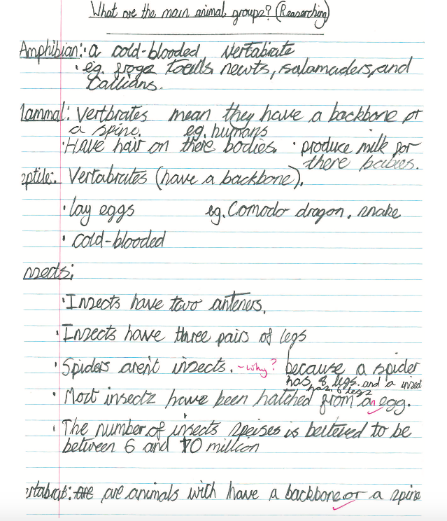

Slide 69
The expectations at end of KS2
Commentary:
The pupil whose work is illustrated has used non-fiction sources independently to:
– locate the sources of the information they need
– retrieve information about the main animal groups
– provide a definition in their own words
– record some of the features used for classification (e.g. that vertebrates lay eggs)
– organise and present the information in an accessible format, using underlining and bullet points.

Slide 70
How is reading assessed?
Ongoing assessment of reading in literacy lessons and across the curriculum.
Tracked through the online tracking system.
PIRA reading tests each term to support our teacher judgements.

Slide 71
How parents can help at home
Reading with your child is vital! It’s best to read little and often, so try to put aside some time for it every day. Give lots of encouragement and expand the reading experience to keep your child switched on.
Focus on encouraging your child to read fluently and with expression, understanding more complex plots and broadening their vocabulary as well as building an understanding of how punctuation and grammar are used.
Notes:
Importance of a text-rich environment
Do any parents have examples of anything they have done at home to encourage a love of reading which has worked well?

Slide 72
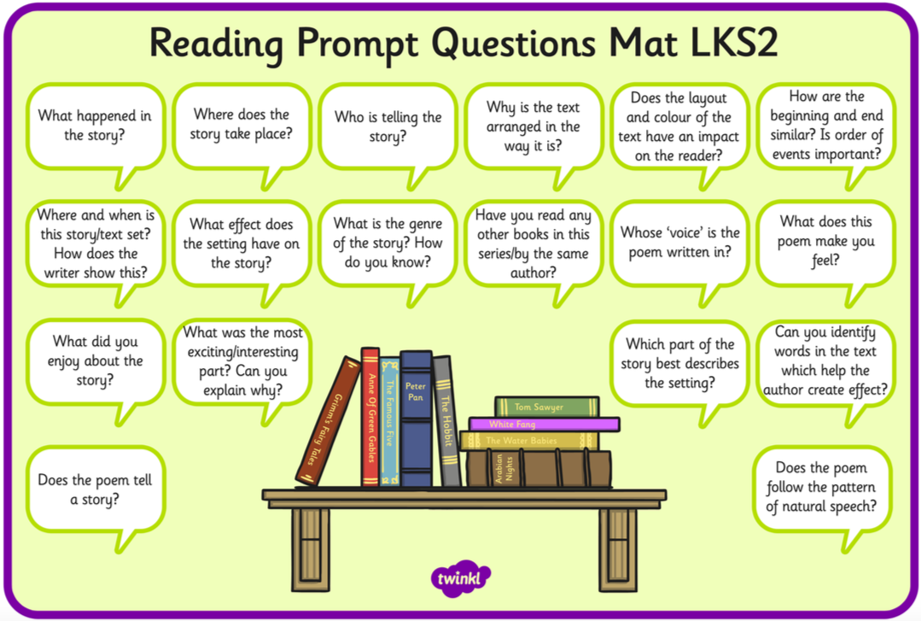
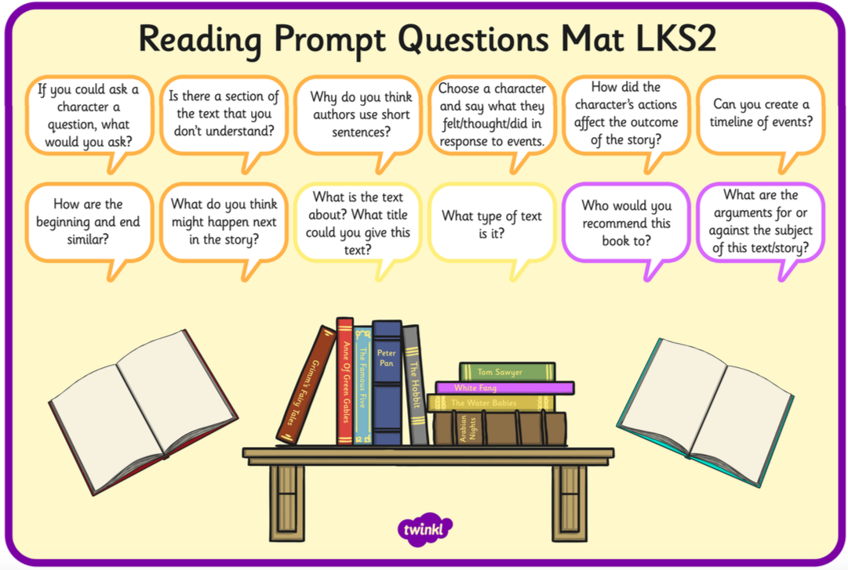
How parents can help at home

Slide 73
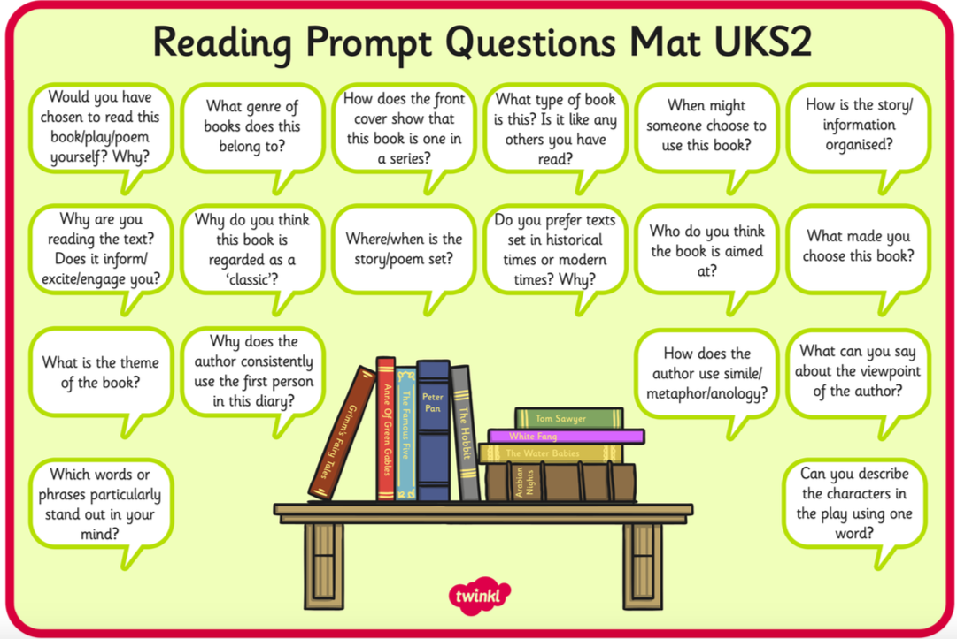
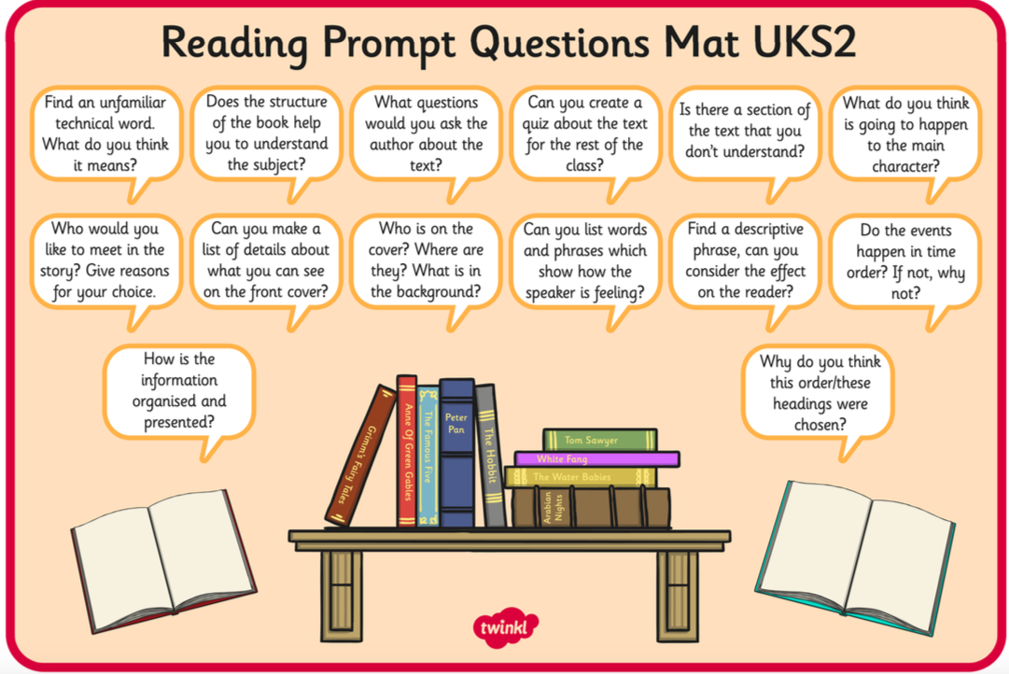
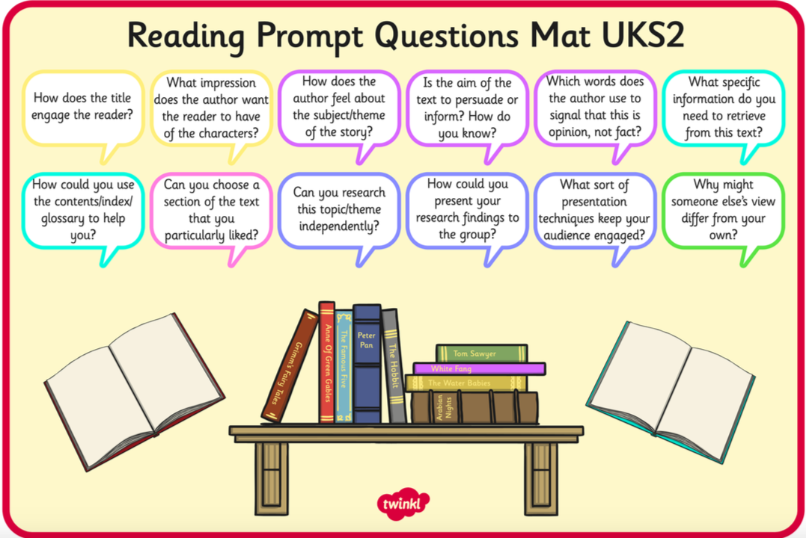
How parents can help at home

Slide 74
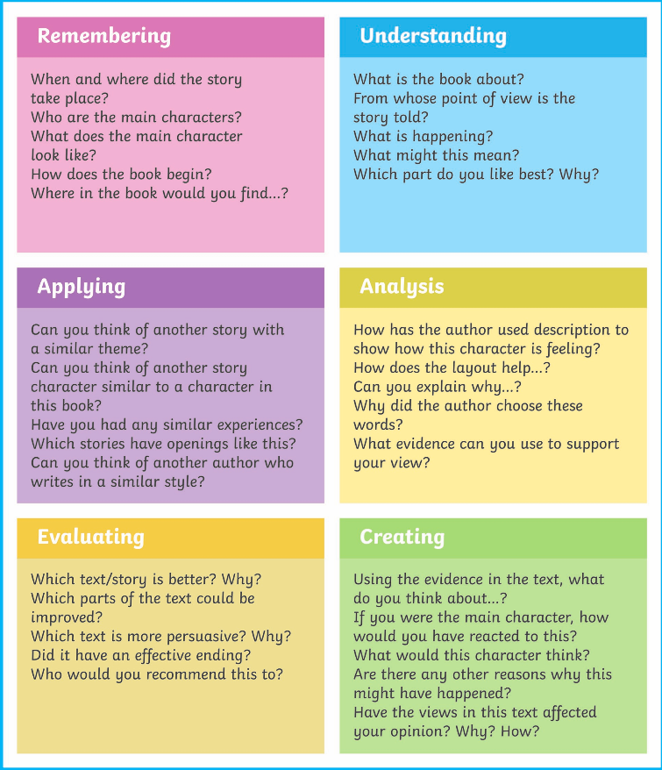
How parents can help at home

Slide 75
How parents can help at home
Use these websites for some inspiration…
Books For Keeps
Booktrust
Chatterbooks
First News
Guardian Children’s Books
Just Imagine
The National Literacy Trust
LoveReading4Kids
Reading Zone
Summer Reading Challenge
World Book Day

Slide 76
How parents can help at home
https://www.booktrust.org.uk/supporting-you/families/reading-tips/examples-of-how-to-read-with-your-child/
http://www.worldbookday.com/ideas/from-the-experts/

Slide 77
Thank you for attending
We greatly appreciate your interest and support in championing reading in our school.

